Slide 1

Serverless Computing: Reducing Infrastructure Management in the Cloud
CSA1516 – Cloud Computing
GUIDED BY:
DR. BOOMIJA M D
PRESENTED BY:
POOJA.S(192524326)

Slide 2
INTRODUCTION
Serverless computing is a cloud computing model where the cloud provider manages servers, infrastructure, and scaling. It allows developers to focus on writing code without worrying about server maintenance. It offers automatic scaling, cost efficiency, and faster application development.
Examples: AWS Lambda, Azure Functions, and Google Cloud Run functions.

Slide 3
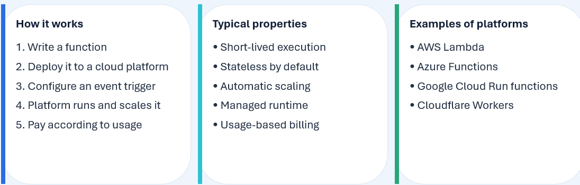
FUNCTION-AS-A-SERVICE (FAAS)

Slide 4
SERVERLESS ARCHITECTURE
1. Event source
2. API / Trigger
3. FaaS Runtime
4. Data / Service
5. Response
Observability
Logs, metrics, tracing, alerts
Security
IAM, secrets, least privilege
Operations
Retries, timeouts, dead-letter queues

Slide 5
CORE TECHNICAL CHARACTERISTICS
Event-Driven: Functions execute when triggered by events or requests.
Automatic Scaling: Resources adjust automatically based on demand.
Stateless Execution: Data is stored in external databases or storage.
Managed Infrastructure: The cloud provider handles server maintenance.
Usage-Based Billing: Charges depend on resource consumption.
Cold Starts: Functions may experience startup delays after inactivity.

Slide 6
BUSINESS ADVANTAGES
Scalability: Automatically adjusts resources based on demand.
Cost Efficiency: Reduces infrastructure costs with usage-based billing.
Higher Productivity: Allows developers to focus on application features instead of server management.
Faster Development: Speeds up application development and deployment.
Reduced Maintenance: The cloud provider manages infrastructure and updates.
Improved Flexibility: Supports rapid changes and business growth.

Slide 7
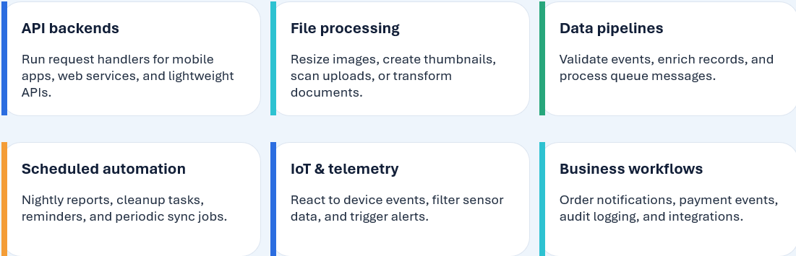
PRACTICAL USE CASES

Slide 8
EXAMPLE: IMAGE UPLOAD PIPELINE
1
User uploads image
Object storage receives the file
2
Storage event fires
New-object event invokes the function
3
Function processes
Validate file, resize image, create thumbnail
4
Save outputs
Write thumbnail + metadata to storage/database
5
Notify application
Publish event or update status for the UI

Slide 9
CONCLUSION
Serverless computing is a flexible and cost-effective cloud model that reduces infrastructure management. It provides automatic scalability, improves developer productivity, and enables faster application development. With applications in APIs, IoT, automation, and data processing, serverless computing helps businesses focus on innovation while reducing operational effort and costs.

Slide 10
THANK YOU

